Slide 1
Deal With It
Nehemiah 13
Rick Griffith • Crossroads International Church • BibleStudyDownloads.org

Slide 2
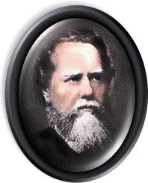
Two Taylor Sons
?

Slide 3
Are you afraid of making commitments
?
Notes:
Are you afraid to make commitments? Sometimes we’re afraid to make them because we neglect to keep them. Have you forgotten any commitments you made to God? Are you keeping the resolutions and goals you made this past January? Or have you compromised your commitments?
1. Did you make a goal of spending more time with your family? Are you keeping it?
2. Some of us covenanted to read through the Bible this year. Are you on schedule as we near the end?
3. How are the rest of us doing in terms of regularly reading God’s Word?
4. Prayer? Are you meeting your goals here?

Slide 4

How can we renew our commitments to God?
Notes:
4

Slide 5

Church Retreat!

Slide 6
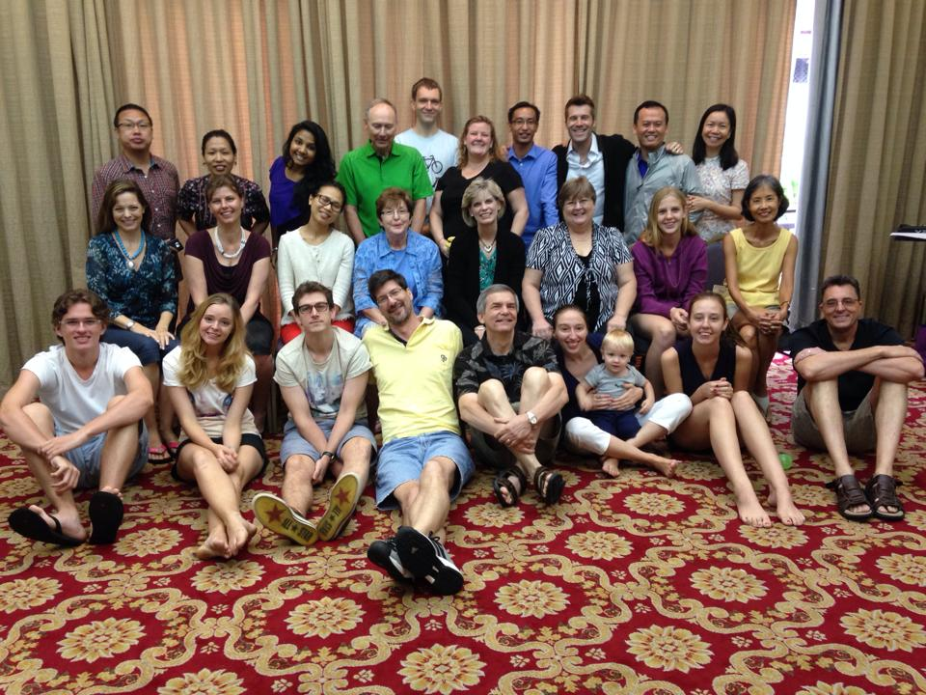
Church Retreat!

Slide 7
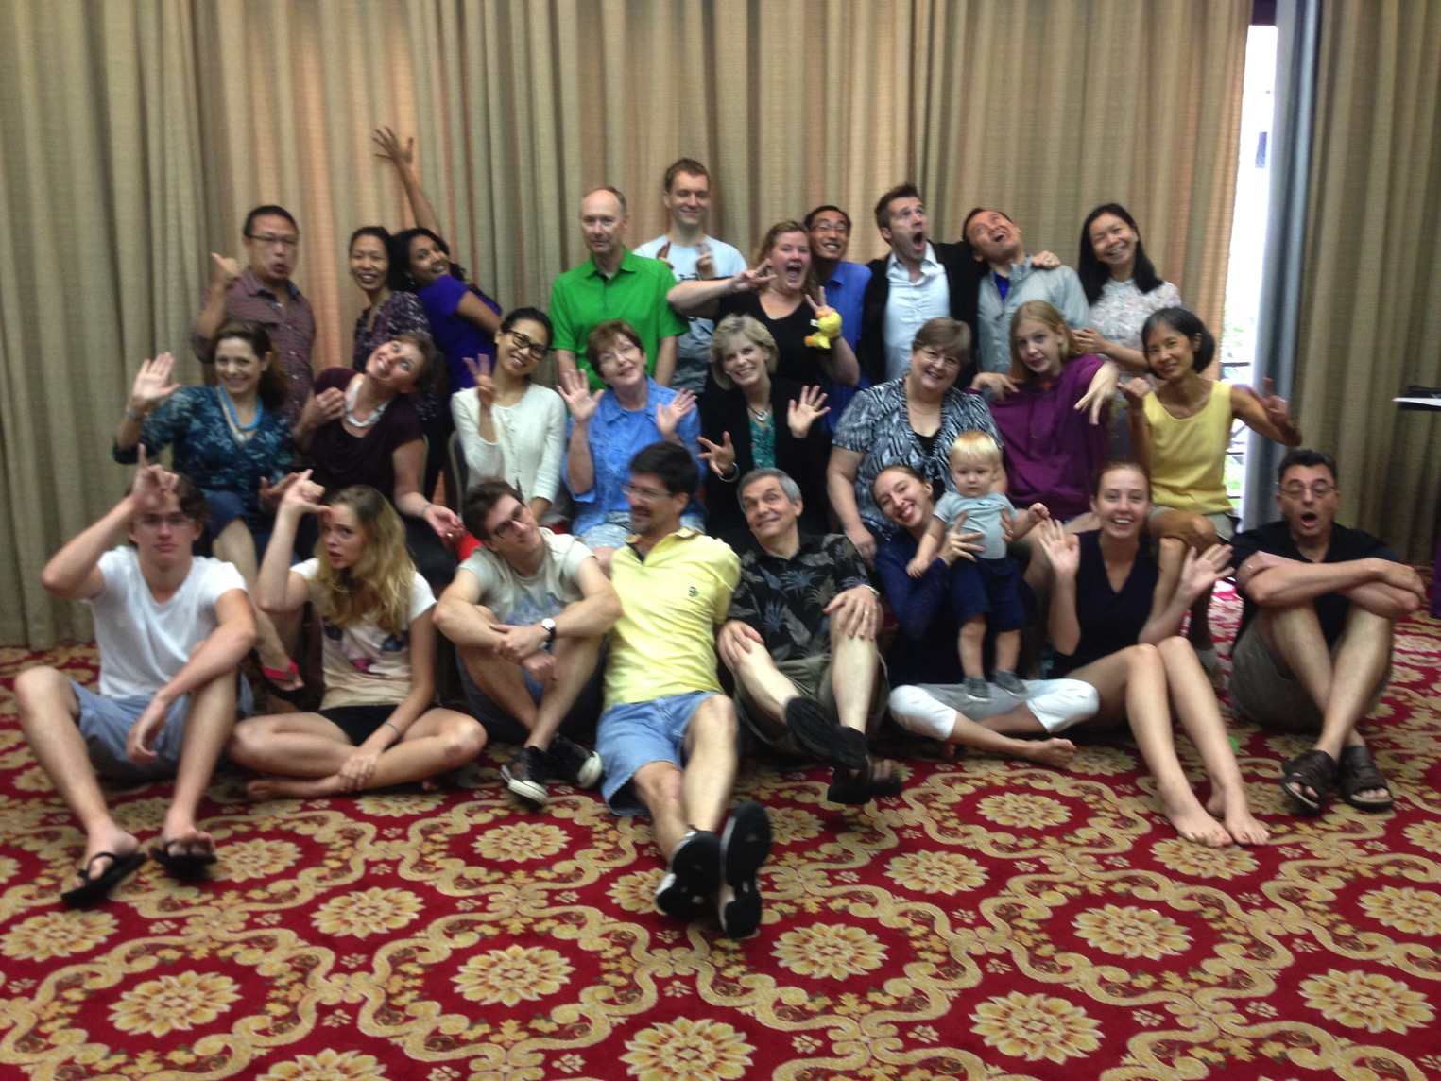
Church Retreat!

Slide 8
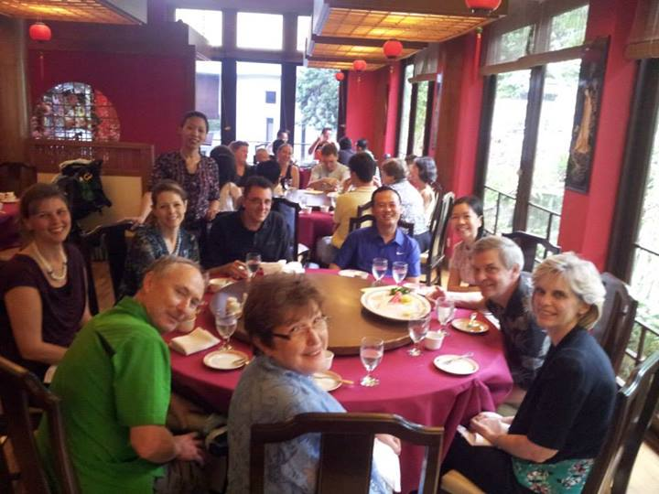
Church Retreat!

Slide 9

Des & Wendy Soh

Slide 10
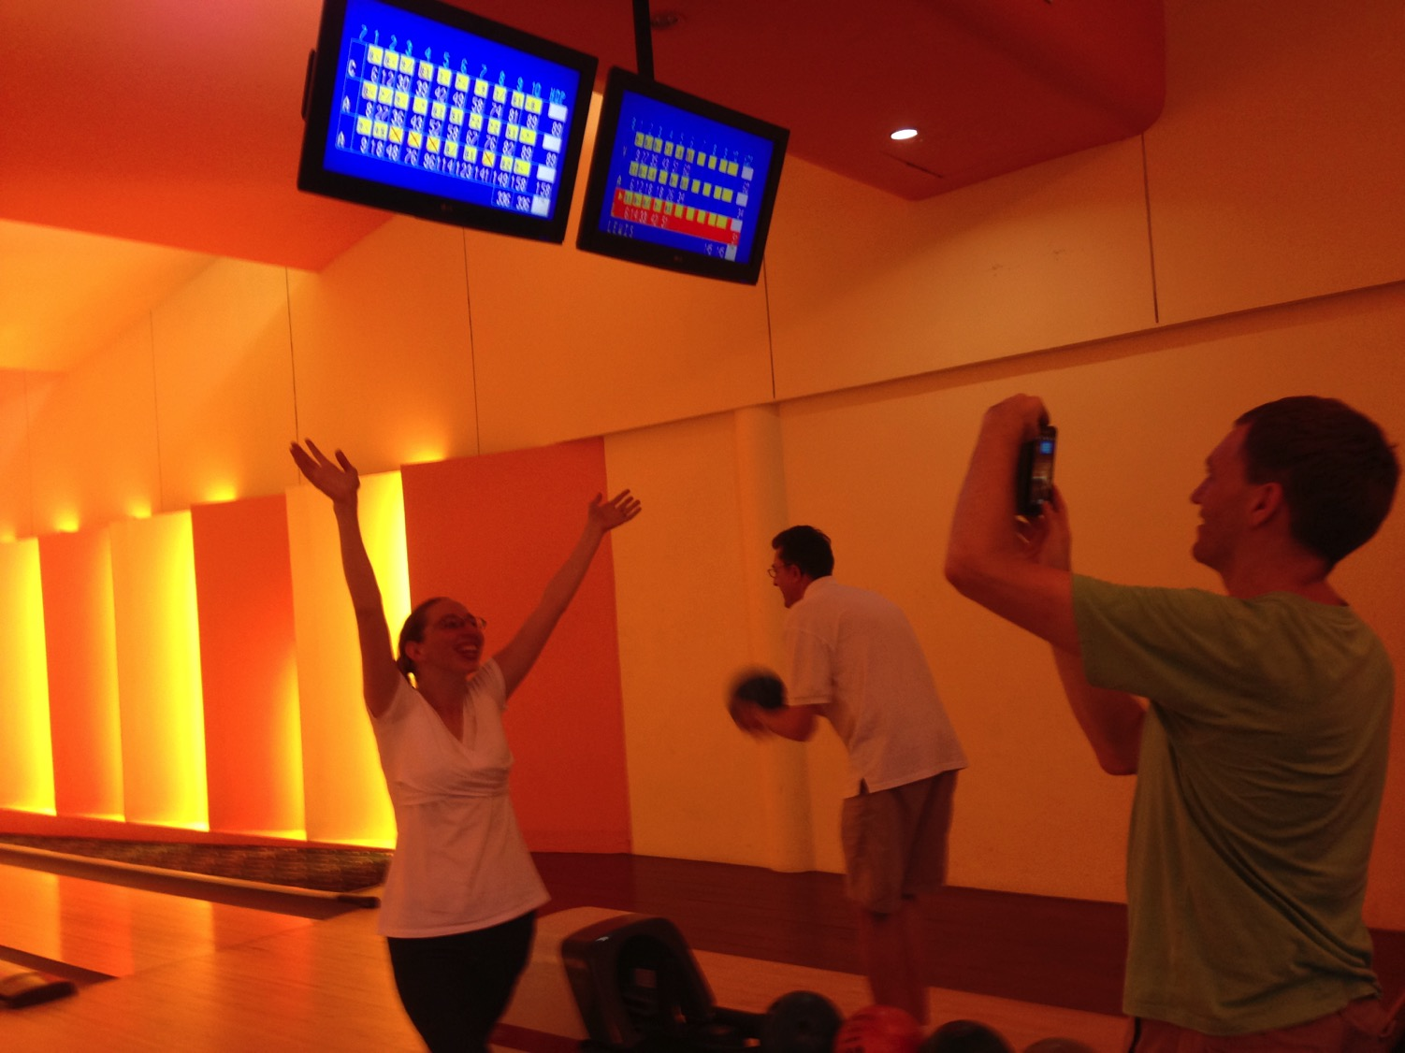
Church Retreat!

Slide 11
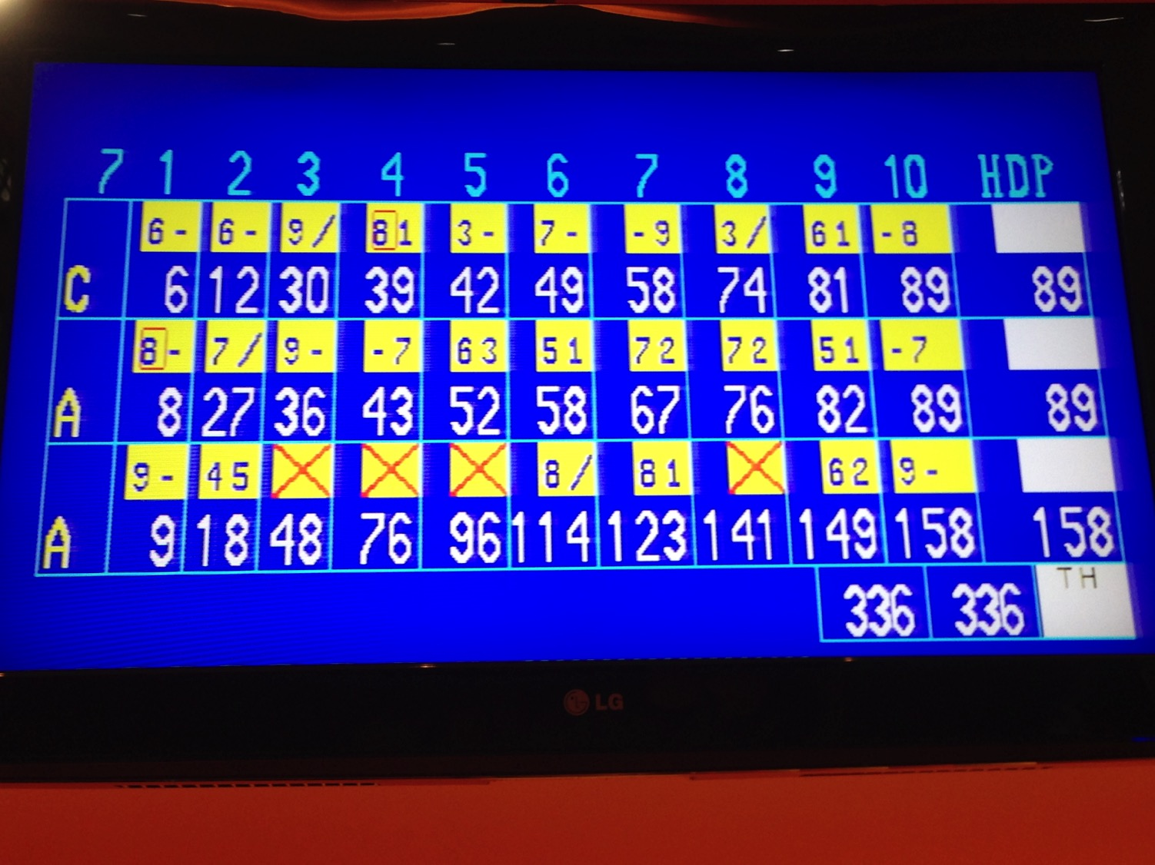
Church Retreat!

Slide 12
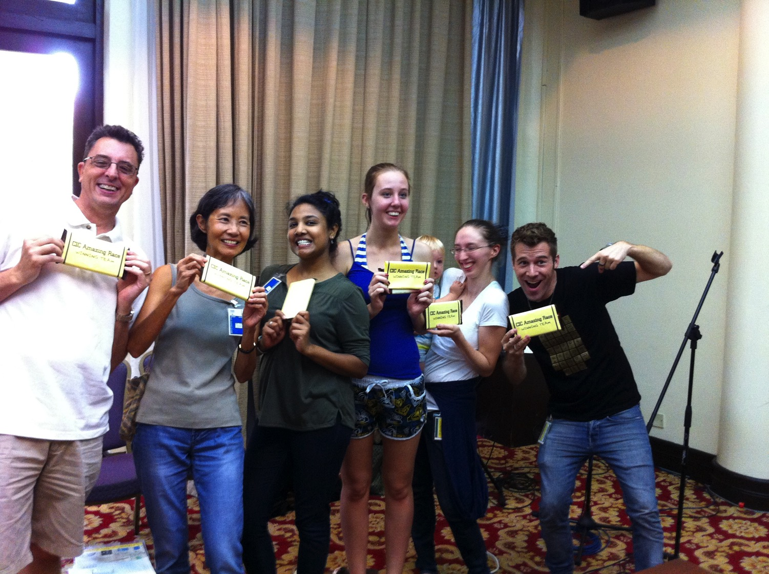
Church Retreat!

Slide 13
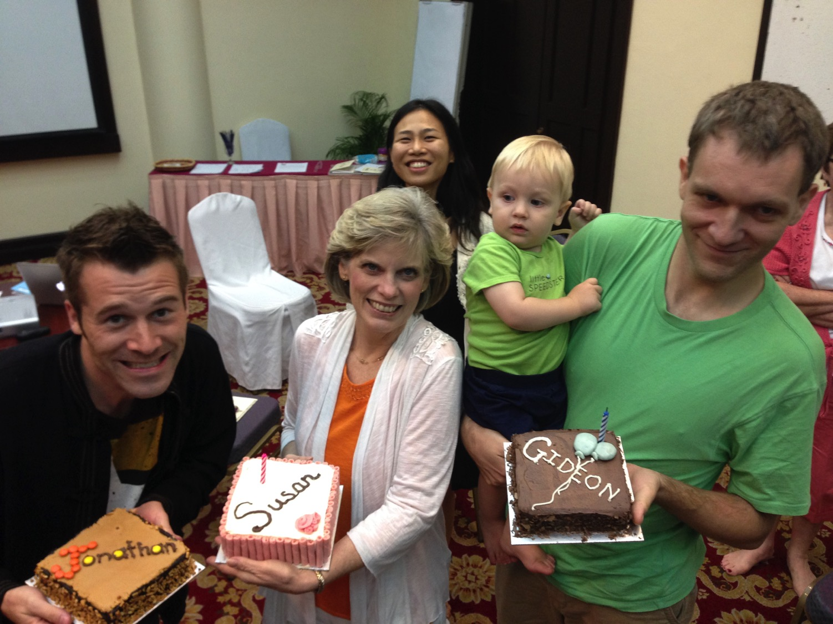
Church Retreat!

Slide 14

Finishing Our Sermon Series
July-October 2013

Slide 15
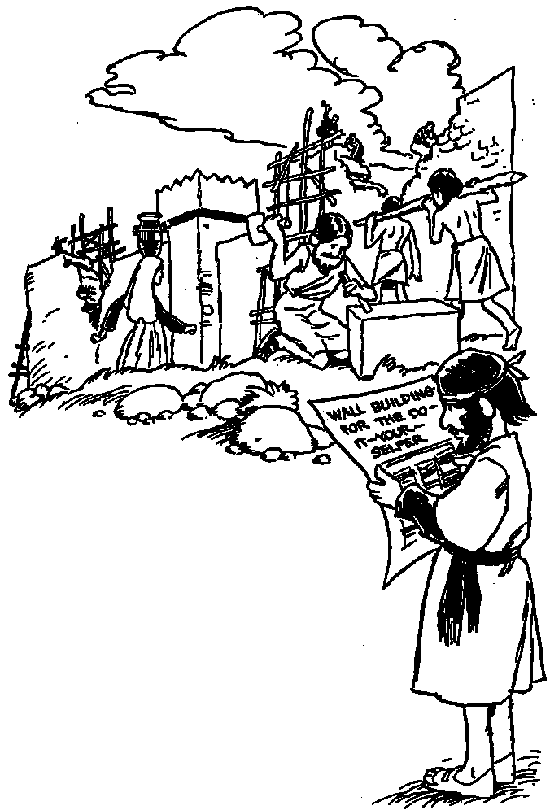
Impossible project?
Notes:
15

Slide 16
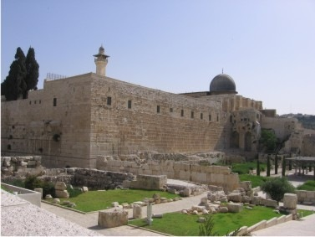
Walls…
Notes:
16

Slide 17
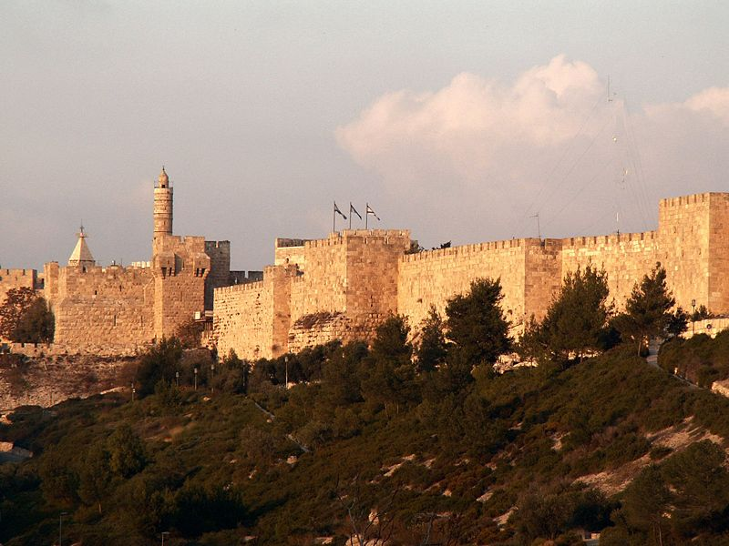
And more walls…
Notes:
17

Slide 18
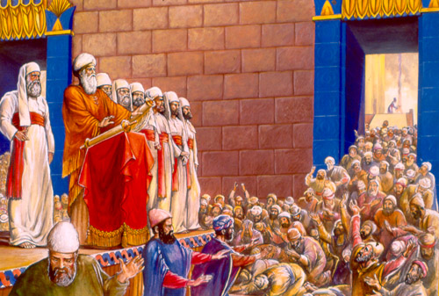
Reading the Law Brought Revival (Neh. 8:8, 18; 9:3)

Slide 19
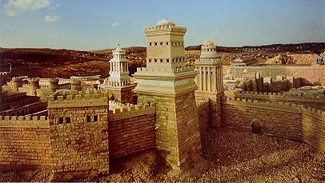
Jerusalem was repopulated (Neh. 11)
Notes:
19

Slide 20
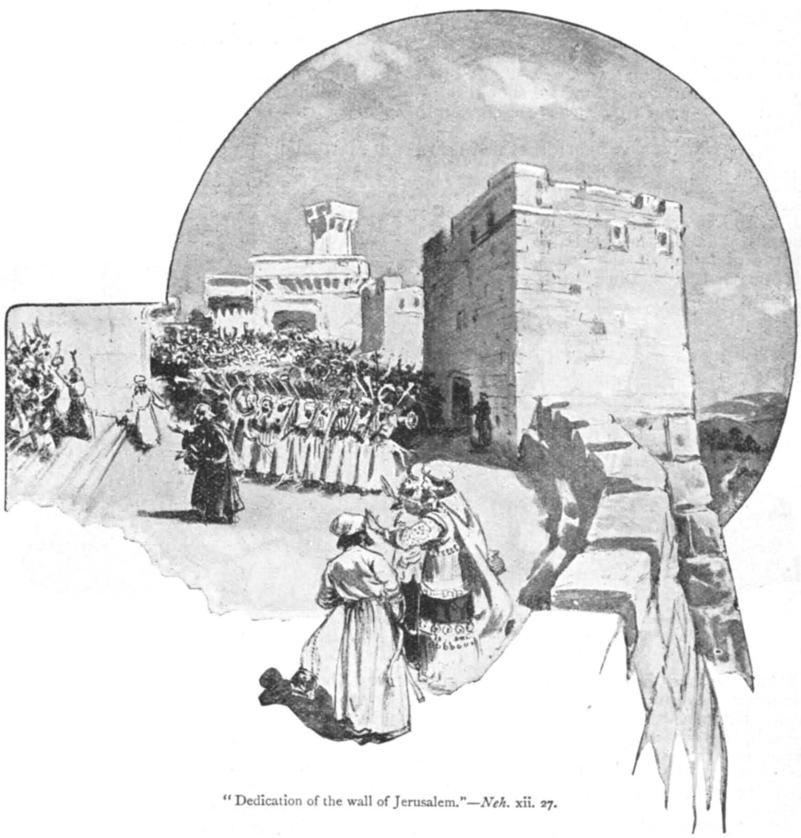
^{They gave thanks (Neh. 12)}
Notes:
20

Slide 21
The Two Choir Procession
Choir 1 (12:31-37) | Choir 2 (12:38-40)
Led south by Ezra | Led north by Nehemiah
Hoshaiah led half of the leaders of Judah | Nehemiah led half of the leaders of Judah
Several singers | 8 singers
Zechariah & 8 priests playing instruments | Jezrahiah & 8 priests playing trumpets
Notes:
21

Slide 22
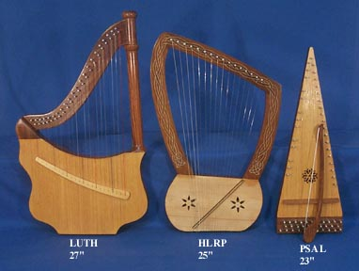
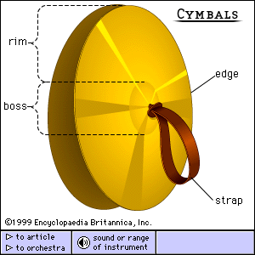
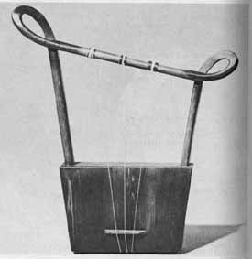
Bring out all the instruments…
Notes:
22

Slide 23
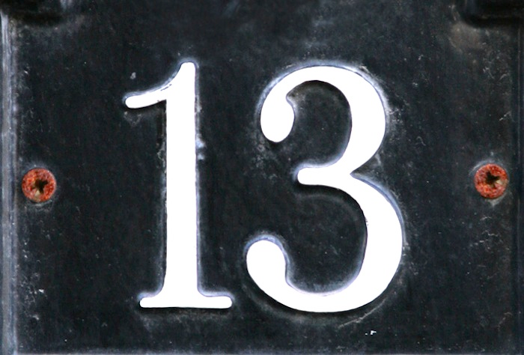


Commitments?
Notes:
But when we come to chapter 13, what a contrast! After 12 years governing Judah, Nehemiah had to go back to Persia for a short time, but during that time, God’s people broke their commitments with God.
Preview: Let’s turn to Nehemiah 13 to see how Israel broke their commitments, what Nehemiah did about it, and then how we can renew our commitments to God

Slide 24
I. The Jews broke four commitments to God
Defiled temple (1-5)

Slide 25
I. The Jews broke four commitments to God
Defiled temple (1-5)
¹On that same day, as the Book of Moses was being read to the people, the passage was found that said no Ammonite or Moabite should ever be permitted to enter the assembly of God. ²For they had not provided the Israelites with food and water in the wilderness. Instead, they hired Balaam to curse them, though our God turned the curse into a blessing. ³When this passage of the Law was read, all those of foreign descent were immediately excluded from the assembly.

Slide 26
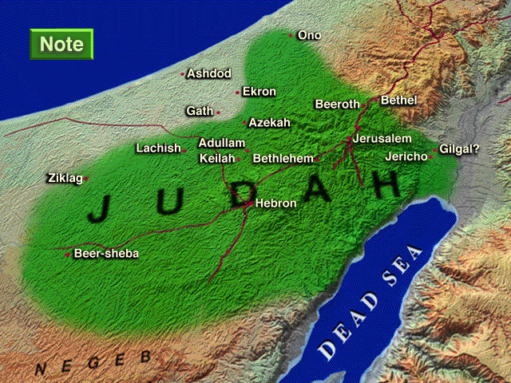

Enemies in Nehemiah 2:19
^{Sanballat}
^{the Samaritan}
^{Tobiah}
^{the Ammonite}
^{NEHEMIAH}
^{Geshom}
^{the Arab}
Notes:
²⁶
^{18�} Then I told them about how the gracious hand of God had been on me, and about my conversation with the king.
They replied at once, “Yes, let's rebuild the wall!” So they began the good work.
^{19�} But when Sanballat, Tobiah, and Geshem the Arab heard of our plan, they scoffed contemptuously. “What are you doing? Are you rebelling against the king?” they asked.
^{20�} I replied, “The God of heaven will help us succeed. We, his servants, will start rebuilding this wall. But you have no share, legal right, or historic claim in Jerusalem.”
Tyndale House Publishers., Holy Bible : New Living Translation., 2nd ed. (Wheaton, Ill.: Tyndale House Publishers, 2004), Ne 2:18.
Map Has Settlements of the Persian Province of Judah According to Ezra and Nehemiah (Logos Libronix Bible Maps, Mac edition, 2008)

Slide 27
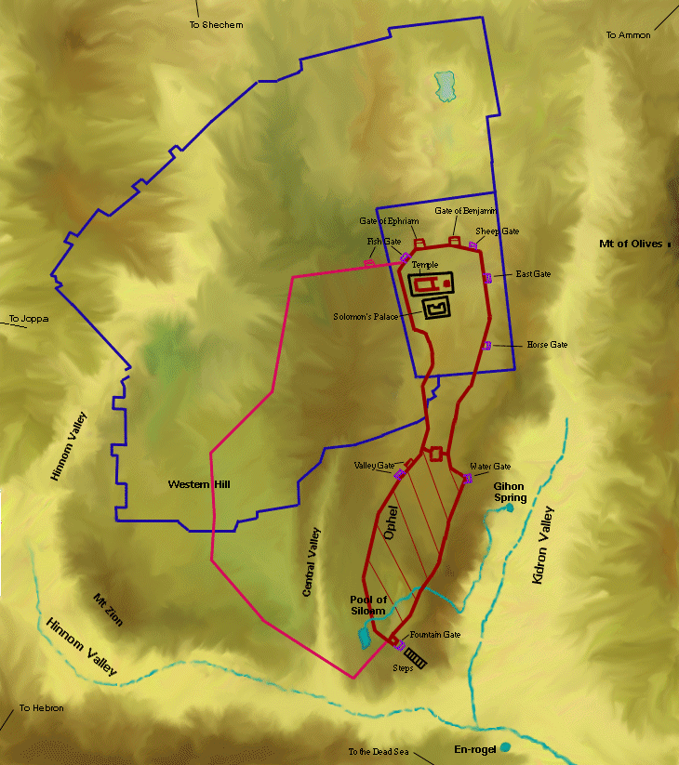
Wall-to-Wall Workers (Neh. 3:1-2)
304
Tower of Hananel
Tower of 100
Mount of Olives
¹Then Eliashib the high priest and the other priests started to rebuild at the Sheep Gate. They dedicated it and set up its doors, building the wall as far as the Tower of the Hundred, which they dedicated, and the Tower of Hananel. ²People from the town of Jericho worked next to them, and beyond them was Zaccur son of Imri.
Sheep Gate

Slide 28
I. The Jews broke four commitments to God
Defiled temple (1-5)
⁴Before this had happened, Eliashib the priest, who had been appointed as supervisor of the storerooms of the Temple of our God and who was also a relative of Tobiah, ⁵had converted a large storage room and placed it at Tobiah's disposal. The room had previously been used for storing the grain offerings, the frankincense, various articles for the Temple, and the tithes of grain, new wine, and olive oil (which were prescribed for the Levites, the singers, and the gatekeepers), as well as the offerings for the priests.
Notes:
Nehemiah 6:17-18 notes that both Tobiah’s wife and his son’s wife were Jews!

Slide 29
I. The Jews broke four commitments to God
Defiled temple (1-5)
Neglected giving (10)
Contra 10:39; 12:47
¹⁰I also discovered that the Levites had not been given their prescribed portions of food, so they and the singers who were to conduct the worship services had all returned to work their fields.
Notes:
In Nehemiah 10:39 and 12:47, they had promised not to neglect God’s house, but now that was exactly what they did

Slide 30
I. The Jews broke four commitments to God
¹⁵In those days I saw men of Judah treading out their winepresses on the Sabbath. They were also bringing in grain, loading it on donkeys, and bringing their wine, grapes, figs, and all sorts of produce to Jerusalem to sell on the Sabbath. So I rebuked them for selling their produce on that day. ¹⁶Some men from Tyre, who lived in Jerusalem, were bringing in fish and all kinds of merchandise. They were selling it on the Sabbath to the people of Judah—and in Jerusalem at that!
Defiled temple (1-5)
Neglected giving (10)
Broke Sabbath (15-16)

Slide 31
I. The Jews broke four commitments to God
²³About the same time I realized that some of the men of Judah had married women from Ashdod, Ammon, and Moab. ²⁴Furthermore, half their children spoke the language of Ashdod or of some other people and could not speak the language of Judah at all.
Defiled temple (1-5)
Neglected giving (10)
Married unbelievers (23-24)
Broke Sabbath (15-16)

Slide 32
I. The Jews broke four commitments to God
Defiled temple (1-5)
Neglected giving (10)
Married unbelievers (23-24)
Broke Sabbath (15-16)

Slide 33
II. Nehemiah confronted the people's errors
Purified temple (8-9, 28)
Prayed
(14, 22b, 29, 31b)
Rebuked leaders (11a, 17-18, 25-27)

Slide 34
Leadership?
294
Do Ezra and Nehemiah teach us proper leadership style?
If so, then whom should you follow?
Intermarriage led Ezra to pull out his own hair (Ezra 9:13)
Intermarriage led Nehemiah to pull out others' hair (Neh. 13:25)!

Slide 35
II. Nehemiah confronted the people's errors
Purified temple (8-9, 28)
Prayed
(14, 22b, 29, 31b)
Temple items (9)
Restored Levites (11b)
Renewed tithes (12)
Fired custodians (13)
Sabbath guards (19-22)
Rebuked leaders (11a, 17-18, 25-27)
Reestablished order (9-13, 19-22a)

Slide 36
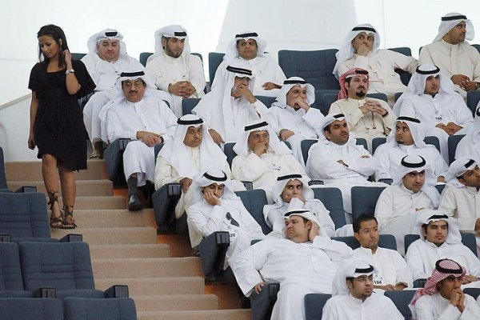
III. Deal with sin decisively.

Slide 37
Jews grew complacent in four areas
Defiled temple (1-5)
Neglected giving (10)
Broke Sabbath (15-16)
Married unbelievers (23-24)

Slide 38
You may not need these solutions!
Purified temple (8-9, 28)
Prayed
(14, 22b, 29, 31b)
Rebuked leaders (11a, 17-18, 25-27)
Reestablished order (9-13, 19-22a)

Slide 39
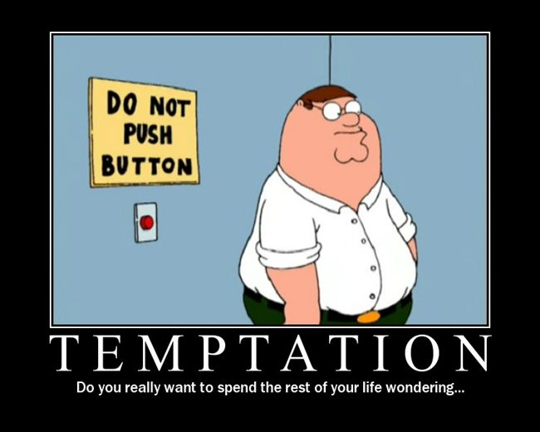
Title
TEMPTATION
Do you really want to spend the rest of your life wondering…

Slide 40
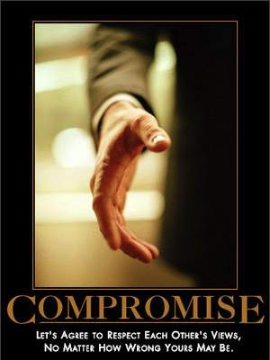
Identify your area of temptation and then deal with it
Saying “yes”
to what we know is wrong

Slide 41
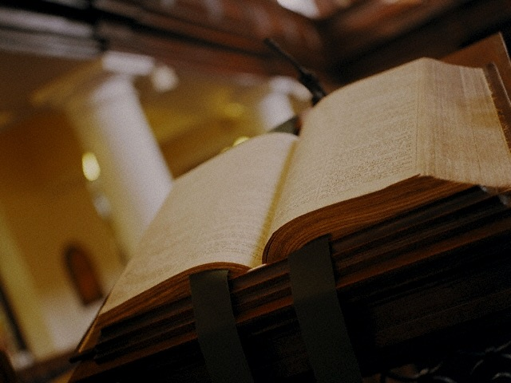
Why Do We Yield to Temptation?
“Regardless of their religious preference, most people deal daily with the temptation to engage in behaviors that they desire to avoid, either because they are morally wrong or are harmful in some way. Studies examining issues of religion and spirituality typically focus on individual beliefs and behaviors such as attendance at religious services and prayer. The limited studies concerning scriptural engagement generally do not go beyond documenting people's Bible reading habits and knowledge.
Arnie Cole, Center for Bible Engagement, Back to the Bible 2009
Notes:
41

Slide 42
Why Do We Yield to Temptation?
“The Center for Bible Engagement has adopted a different approach. Our research focuses on why so many people own Bibles, but never read them, and once this is discovered, to find a solution.
“In our four years of research, including several surveys with over 40,000 respondents, we have discovered that familiarity and contact with the Bible provides a level of protection against temptation and is correlated with less involvement in risky behaviors, such as pornography and destructive thoughts…”
Arnie Cole, Center for Bible Engagement, Back to the Bible 2009
Notes:
42

Slide 43

Why Do We Yield to Temptation?
• 40,000 web surveys (American Christians & nonbelievers)
• 62% women + 38% men (81% white, 9% African-American)
• Ages 13 to 75+ (median age of 47 years)
• Mostly open-ended questions
Center for Bible Engagement, Back to the Bible 2009
Notes:
Back to the Bible has been researching extensively since 2005—including 40,000 respondents—both believers and unbelievers.
About three-fifths (61.8%) of respondents were women. Survey participants range in age from 13 to over 75, with a mean of 44.8 years (standard deviation = 14.7) and a median of 47 years.
Most survey respondents (80.9%) identify themselves as White. A little less than one-tenth (8.9%) were African-American.
The majority (66.5%) were married. About one out of five were either divorced (11.3%) or single/never married (17.2%). Only 1.5% of respondents indicated that they were “living with a significant other”.
Those who completed the surveys were fairly well-educated. Nearly half (44.0%) had at least a college degree. An additional 30.9% had some college education.
43

Slide 44
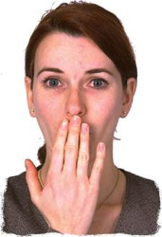
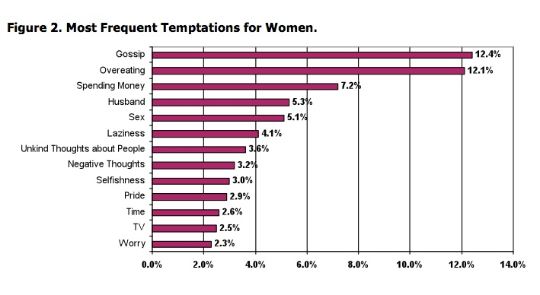
Women's Sources of Temptation
Center for Bible Engagement, Back to the Bible 2009
Notes:
Women's temptation sources are spread all over the map.
So what do you think was the biggest temptation for men?
44

Slide 45

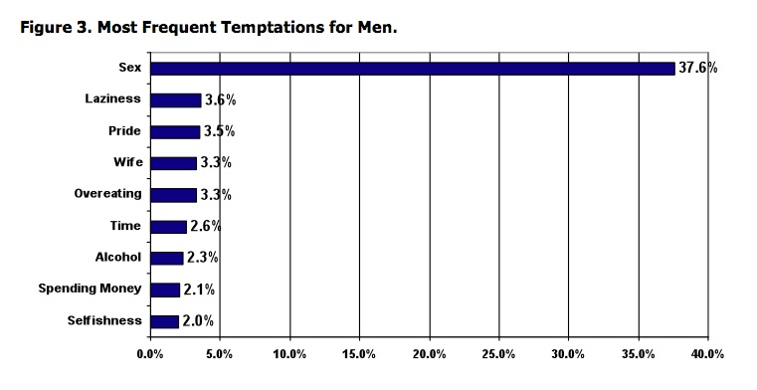
Men's Sources of Temptation
Center for Bible Engagement, Back to the Bible 2009
Notes:
Men's temptation sources are “slightly more focused” (!) on SEX which tempts 37% of men, which is ten times as great a temptation as any of the other sources! I think this figure of 37% also shows that 63% of men surveyed lied. Sex is every man's battle!
45

Slide 46

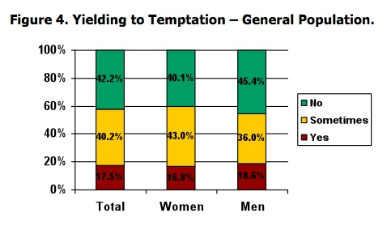
About 60% Yield to That Temptation
Center for Bible Engagement, Back to the Bible 2009
Notes:
About 60% of those surveyed said that they yielded to that temptation (generally sex for men and more gossip or overeating for women than anything else). I'm just adding up the YES and SOMETIMES figures.
OPTIONAL: “Men were significantly more likely than women to indicate that they did not yield to temptation. It is very likely that yielding is related to the type of temptation (e.g., sex vs. gossiping) and so the differences observed in Figure 4 may result from the different types of temptation men and women face, rather than any fundamental difference in ability to resist enticement” (p. 7)
46

Slide 47
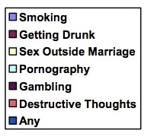
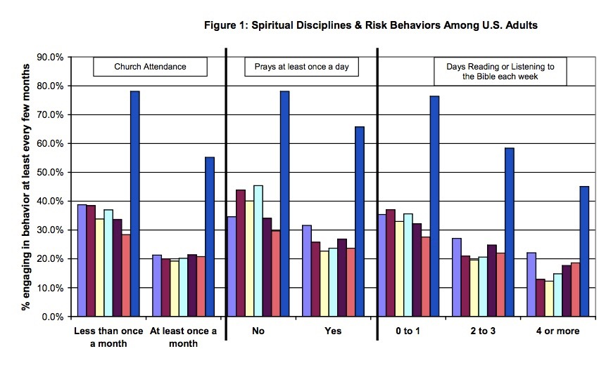
What's your solution?
(lower is better)
Church Attendance
Prayer Daily
Days of Bible Reading
Center for Bible Engagement, Back to the Bible 2009
Notes:
Now which of these three strategies helps us fight temptation best: (1) Church Attendance, (2) Daily Prayer, or (3) Bible Reading?
Observations:
Church attendance significantly reduces risky behavior from 30-40% for those who don't attend church down to around 20% for those who attend at least monthly. Keep attending!
Prayer seems not to have any significant effect on risky behavior. (The study doesn't ask which God they pray to!)
There are no statistically significant differences between those who read or listen to the Bible 0-1 days a week and those who spent 2-3 days doing so.
Those who read God's Word 2-3 times weekly are as likely to fall to temptation as those who pray daily!
The key difference is those who read the Bible 4 or more times weekly. They commit sexual immorality half as much as those reading 2-3 times weekly!
47

Slide 48

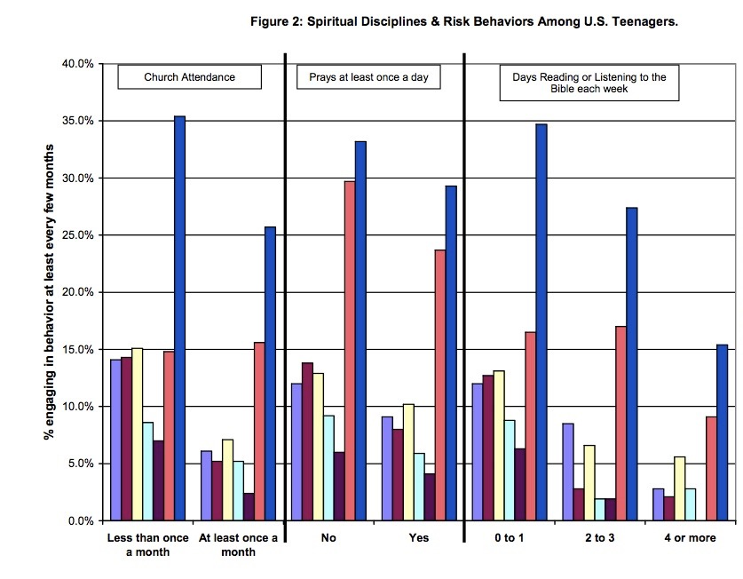
Teen Disciplines & Behavior
Church Attendance
Prayer
Daily
Days of Bible
Reading
Center for Bible Engagement, Back to the Bible 2009
Notes:
Another encouraging sign is to see the scale for teens. Note that, at the worst, only 35% of teens are involved in ANY of these behaviors—whereas for adults the worst figure is almost 80%!
In other words, teens have BETTER morals than adults (assuming they told the truth on the survey!). For example, 5% of teens reading Scripture most of the week had sex outside of marriage every few months whereas 12% of adults in the same Bible reading category failed here.
The one area where frequent Bible reading didn't help teens so much is in their destructive thoughts—probably because their Bible reading was supplemented by destructive movies, destructive music, and destructive computer, X-Box, and Wii games.
48

Slide 49
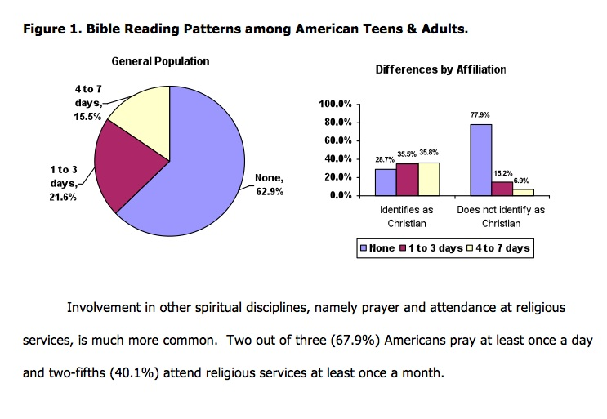
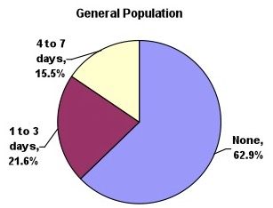
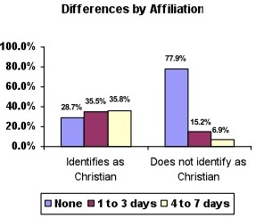
Bible Reading Patterns
Center for Bible Engagement, Back to the Bible 2009
Notes:
About 63% of Americans never read the Bible, even though the average US home has FOUR Bibles!
Of course, the pie chart relates to all people—Christian and non-Christian. On the bar chart you see that Christians fall roughly evenly into the three categories of: (1) no Bible reading, (2) 1-3 days Bible reading, and (3) 4-7 days Bible reading per week.
I don't find it surprising that 40% of Americans attend a church service at least once a month.
What is amazing is that 68% pray daily! Except that surveys didn't ask which God they prayed to!
49

Slide 50
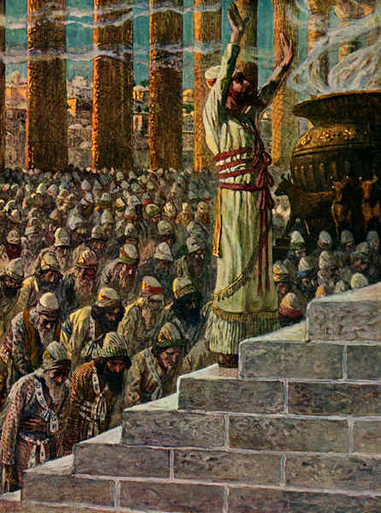
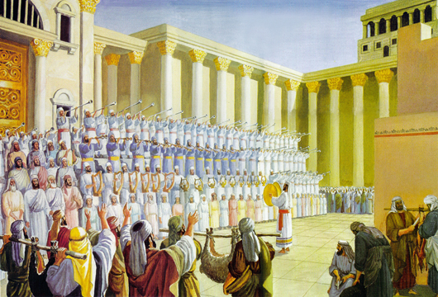
God's Word changed behavior in the Jews
Notes:
50

Slide 51
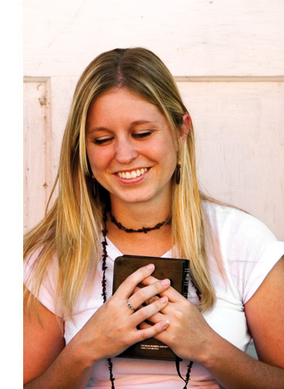
“The Power of 4”
Christians who are engaged in Scripture four or more days of the week have lower odds of participating in these behaviors:
^{Smoking = 36% lower odds}
^{Getting drunk = 57% lower odds}
Sex outside marriage = 68% lower odds
^{Pornography = 61% lower odds}
^{Gambling = 74% lower odds}
Any of these habits = 57% lower odds
Center for Bible Engagement, Back to the Bible 2009
Notes:
So do you want to conquer the temptation of risky behavior? Read Scripture daily!
The researchers call this “The Power of 4” as the key factor is reading God's Word at least 4 times a week… [click and read slide]
51

Slide 52
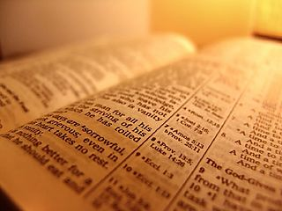
How can we renew our commitments to God?
The Big Idea
Deal with sin decisively!

Slide 53

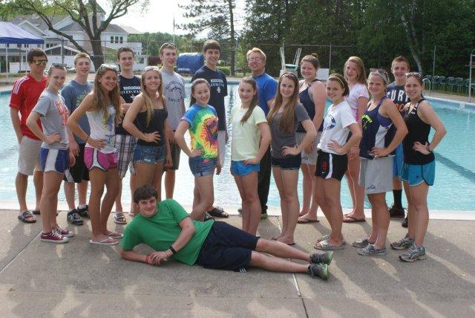
A Proposal
“You are planning to destroy God’s people! No healthy relationship can be built without God’s Word. Once you don’t base it on God’s Word and follow secular activities, you fail in your ministry before God. Please bear in mind that our aim is to help people become Christ-like, not world-like.”

Slide 54

Is it willpower? No!
TEMPTATION
Because willpower is no match for horsepower.

Slide 55

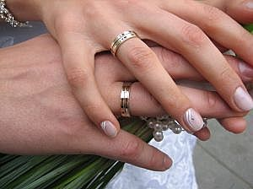

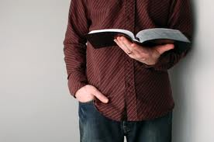
Where are you most tempted?

Slide 56
Black

Slide 57


OT Preaching link at BibleStudyDownloads.org
Get this presentation for free!
Notes:
OT Survey (os)

